Slide 1
TechSphere Global Retailer Performance and Data Analysis
Oghinan Daniel
October 3rd 2024

Slide 2
Project Outline
Executive Summary
Introduction
Methodology
Findings
Conclusion
Appendix

Slide 3
Executive Summary
Objective
Provide insights into sales performance, customer behavior, product performance, and store efficiency to inform strategic decisions.
Key Findings
Sales Trends: Identified monthly sales patterns and high-performing years.
Customer Insights: Analyzed demographics and spending behaviors across regions.
Product Performance: Highlighted top-selling products and revenue drivers by category and subcategory.
Store Performance: Evaluated store contributions, sales by location, and efficiency metrics (e.g., sales per square meter).
Next Steps: Use these insights to improve marketing strategies, effectively allocate production resources, and focus on high-performing areas to drive growth.

Slide 4
Introduction
TechSphere Global Electronics Retailer is looking to boost profitability in the coming years, analysis will be carried out on existing data to understand and interpret the insights obtained from the data, recommendations and decisions will be made using the information we have.
The main objectives of this project analysis are to:
identify strategies that can be implemented to increase awareness and drive sales.
analyze product(categories and subcategories) and brand performance.
determine store performance in different countries.
identify low value stores and weak performing products.
determine the overall success of sales over the years.

Slide 5
Methodology
The data for this project was gathered from the maven analytics data playground, cleaned and ready for use.
The project began by identifying major questions that would need to be answered, these answers would prove valuable to TechSphere moving forward.
The data in different tables were merged and transformed to suitable formats that would be used later on in the project with a focus on profit.
Visualizations are used to clearly show the relationship between different data groups (e.g total profit by country).
Technical tools used In the project are PostgreSQL for extensive analysis on the data in the pgAdmin4 interface, and python programming language for data visualization.

Slide 6
Information Overview
Results obtained from basic descriptive analysis:
$32,662,688 made in profit from 62,884 orders.
2,517 different products put for sale.
Most Profitable Brand: Adventure Works.
For every year, April has been the worst performing month by a wide margin.
9 stores haven't made any sale.
23 out of the 25 products that did not sell were lamps.

Slide 7
Key Findings and Insights Drawn from Exploratory Data Analysis

Slide 8
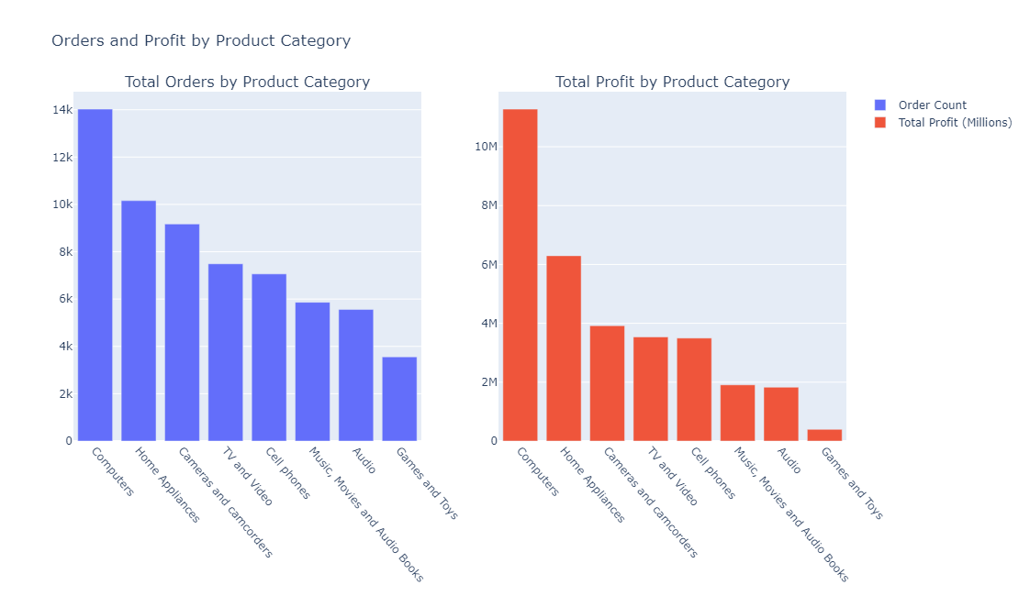
Total Orders and Profit by Product Category
The Computers category is at the top of the list, with almost $5million more than home appliances.
The games and toys sections have generated the least profit.
Full image here

Slide 9
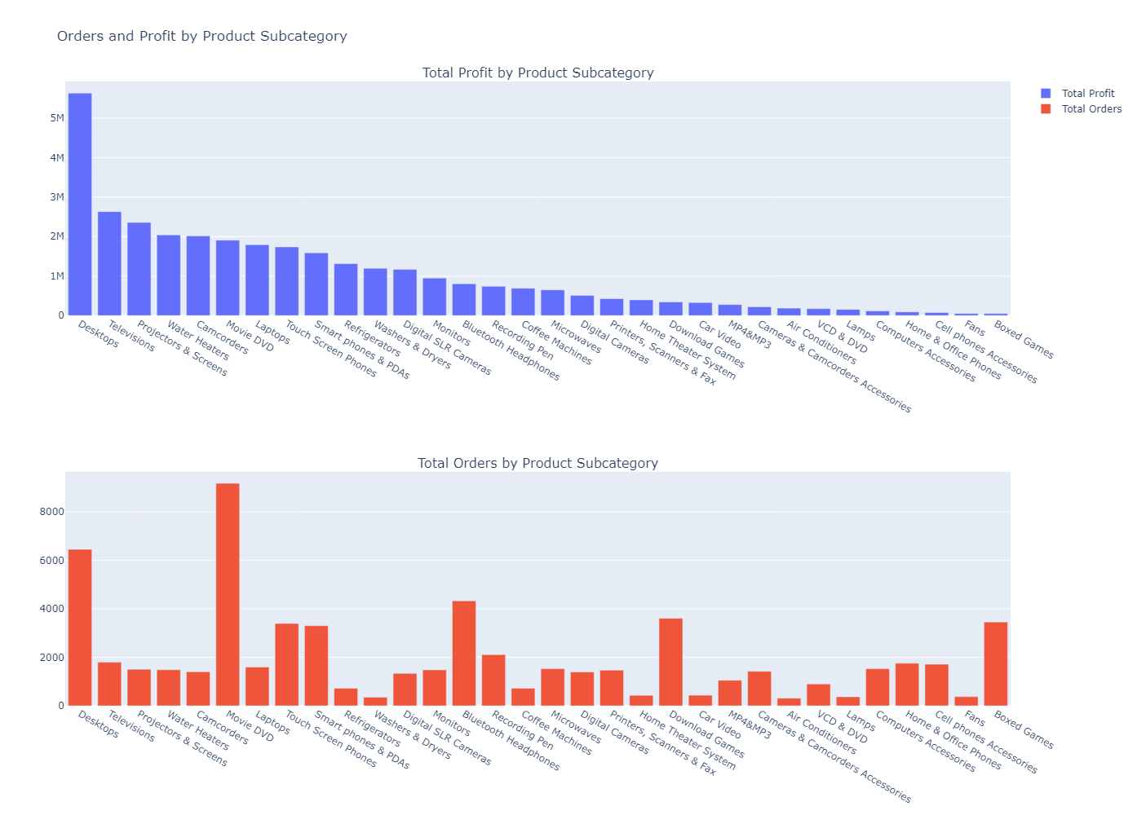
Total Orders and Profit by Product Subcategory
Desktops alone have brought in over $5.6million In profit for the TechSphere.
Movies/DVDs are the most ordered products with 9,196 total orders.
Boxed games have the 5th highest orders but the lowest profitability with $51.9k generated.

Slide 10
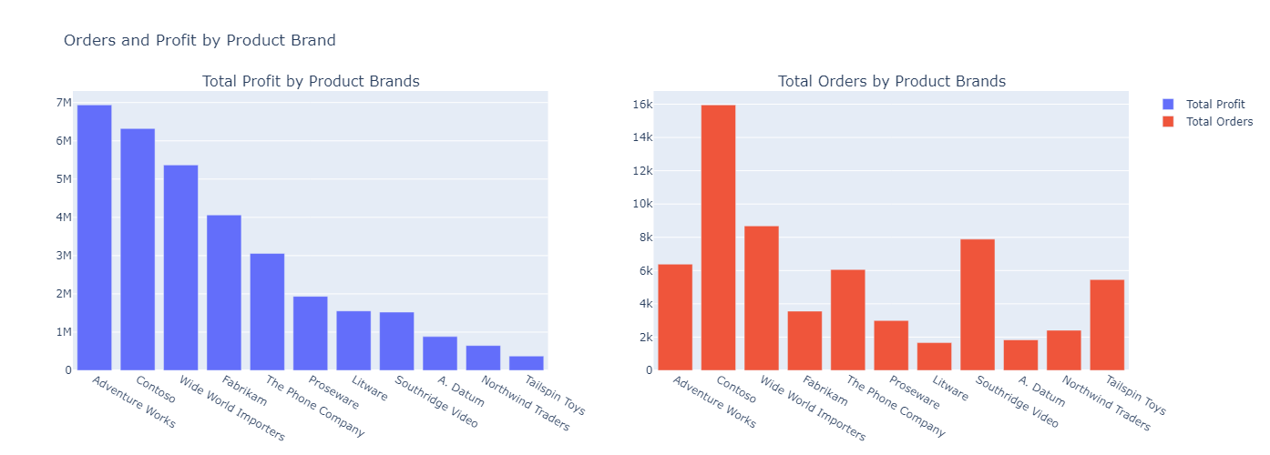
Total Profit Brought in by Brands
Even with less than half the number of orders than Contoso, Adventure Works is our most profitable brand.
Contoso brand is in highest demand from customers based on number of orders.

Slide 11
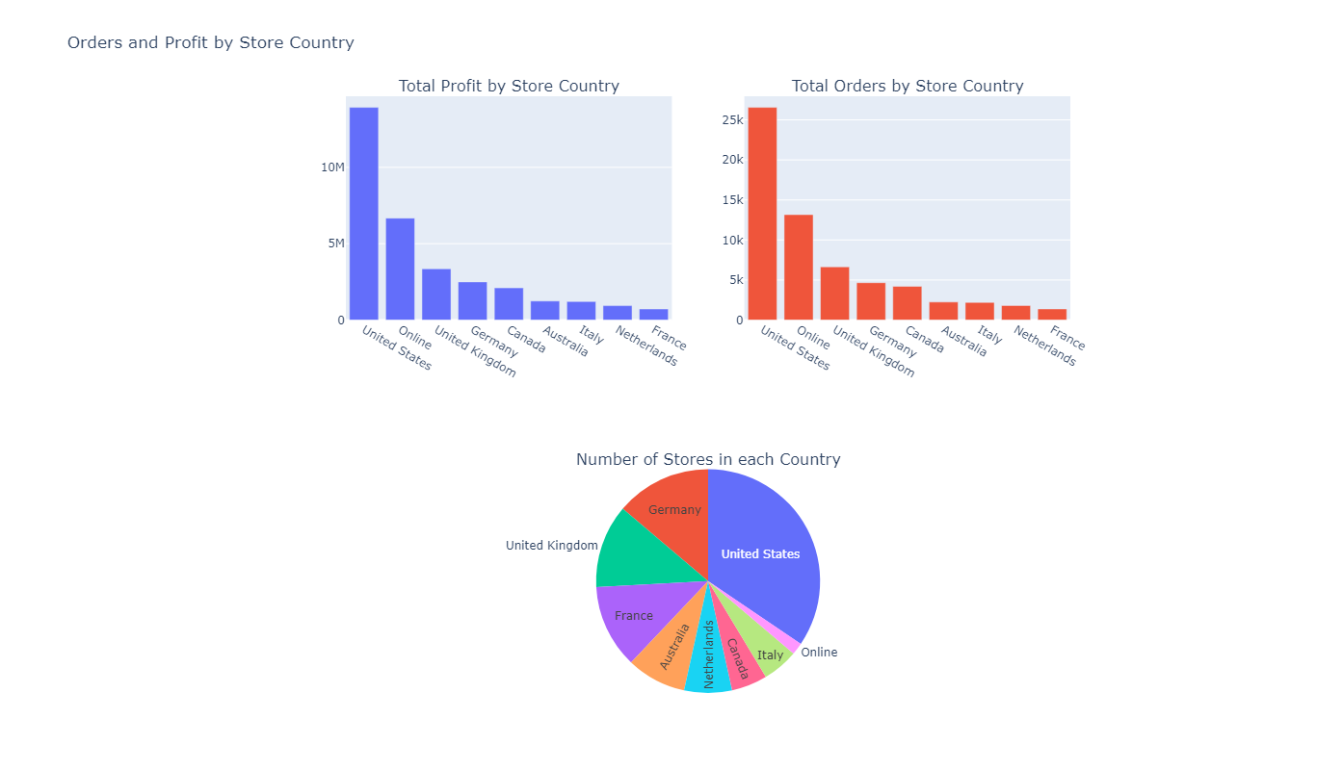
Profit Generated by Stores
Majority of sales and orders come from the United States.
Number of stores set up have strong correlation with performance of sales.
A large amount of profit and orders come from TechSphere online stores.

Slide 12
Stores With No Sales
The following stores made no sales within the analysis period:
State | Store key | Country
Delaware Mississippi North Dakota Rhode Island | 46 52 58 60 | United States
Mecklenburg-Vorpommern | 25 | Germany
Yukon New Brunswick | 11 7 | Canada
South Australia | 3 | Australia
Zeeland | 35 | Netherlands

Slide 13
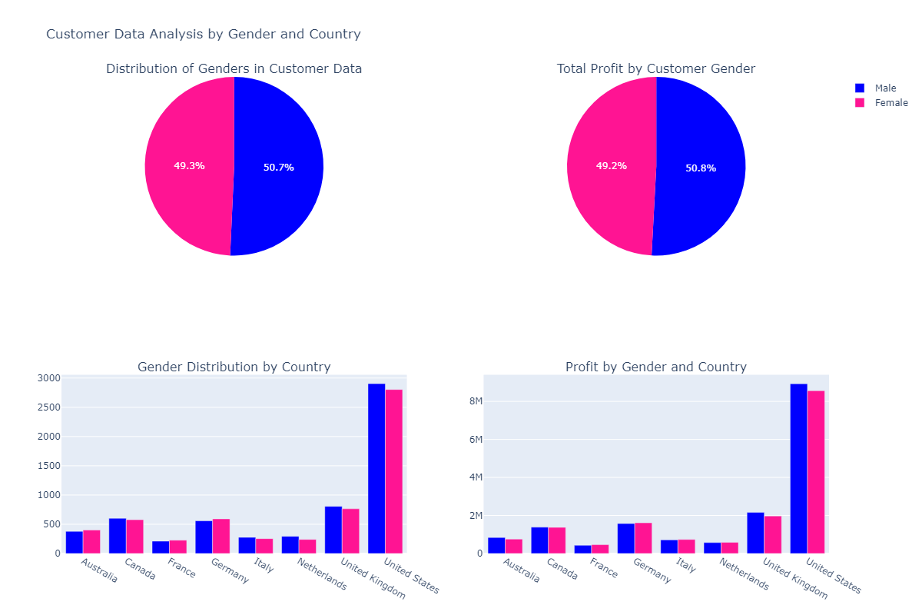
Customer Analysis (Gender and Country)
There are more males than females overall
TechSphere customer base is almost evenly distributed between males and females.
Number of customers in different locations directly impact the profit made in that location.

Slide 14
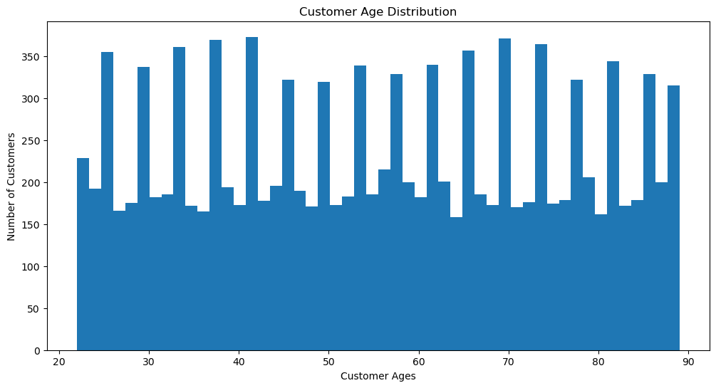
Customer Analysis (Age Distribution)
The chart shows that TechSphere attracts customers in the mid 20s up to the late 80s.
The number of customers is somewhat evenly distributed.
Frequent Spikes in certain age groups but none that stand out.

Slide 15
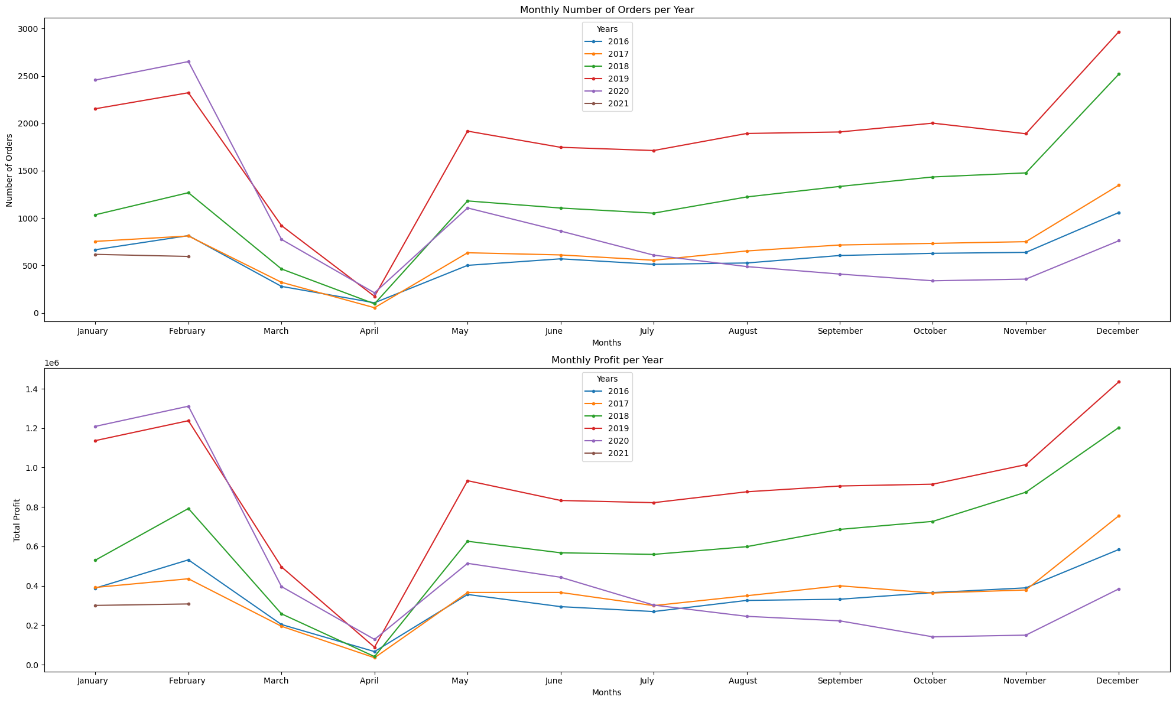
Sales Information Overtime
Profit and orders are at an all-time low in the month of April for every year with sales in that month.
April has always been a bad month for TechSphere.

Slide 16
Conclusions
Problem statement
For physical stores, 42.2% of orders and 42.6% of our total profit were made in stores In the United States, which is where 34.5% of our stores are located, attracting the majority of our customers. We are losing out on lots of potential customers.
Yearly Profit has been on a major decline from 2016-2021.
Recommendations
More marketing efforts should be put in other countries where we have a smaller customer base, for our physical stores, a 30% increase in profit from other countries will increase our overall profit(including the US) by 11%.
Adventure Works brand contributes 10.1% of orders and have generated the most brand profit(21% of total profit); priority should be placed on getting more orders to the brand.
Production costs for low performing subcategories can be channeled to higher performers getting more orders.
Attention should be paid to stores with no sales for the analysis period; the root cause would need to be further investigated to determine best action to be taken afterwards.

